Slide 1

INCOME TAX RETURN FILING
Important issues and Presumptive taxation
Organized by:
Direct Taxes Committee of ICAI
Date: 1st October, 2026
CA. Chandrashekhar V. Chitale CA. Pankaj Shah
Chairman, DTC, ICAI Vice-Chairman, DTC, ICAI
Speaker:
CA. Apurva Mehta

Slide 2

ITR Filing (Departmental Utility):

Slide 3
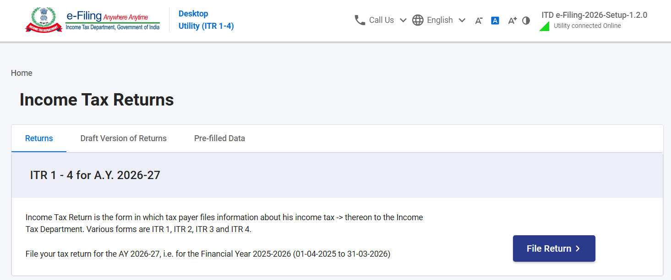
ITR Filing (Departmental Utility):

Slide 4
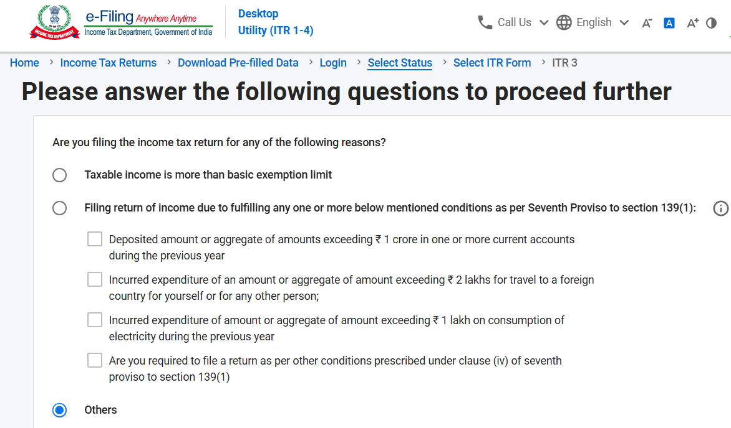
ITR Filing (Departmental Utility):

Slide 5
ITR Form 1:
Only For individuals (residents other than not ordinarily residents) having total income upto Rs. 50 Lakhs and having income from Salary, two house properties, income from other sources and Long term Capital Gain chargeable to tax u/s. 112A upto Rs. 1.25 Lakhs and agricultural income upto Rs. 5,000/-.
Individuals excluded from filing ITR-1:
Director of any company
Holds unlisted equity shares
If TDS deducted u/s. 194N on cash withdrawal
Foreign Assets (incl. financial interest in any entity)
If Total Income is more than Rs. 50 Lakhs
Agricultural income above Rs. 5,000/-
Long Term Capital Loss / Short Term Capital Gain / Loss or LTCG exceeding Rs. 1.25 Lakhs under Section 112A
Capital Gain / Loss from sale of land or building, etc.
Tax has been deferred on ESOP issued by an eligible start-up
Person having business income cannot file ITR-1

Slide 6
ITR Form 2:
For individuals and HUF – not having income from business / profession
All kind of capital gain transactions covered
Non-residents and person not ordinarily resident can file ITR-2.
An individual who is not eligible to file ITR-1 and does not have business income should file ITR-2.

Slide 7
ITR Form 3:
For individuals and HUF - having income from business / profession
If an assessee is having Income from business or profession (chargeable to tax under presumptive taxation u/s. 44AD / 44ADA / 44AE) + Capital Gains, then ITR-3 shall be applicable and not ITR-4.
If a person is having Income from business or profession (other than presumptive income), say, Commission Income or is filling up Balance Sheet and Profit and Loss Account and not opting for presumptive taxation u/s. 44AD / 44ADA / 44AE, ITR-3 shall be applicable and not ITR-4.
No limit on total income or any capital gain and no limit on any agricultural income.
Individual and HUF whose audit is conducted are required to file ITR-3 and cannot file ITR-4.

Slide 8
ITR Form 4:
For individuals, HUF and firms (not being LLP) being resident – having income from business / profession – chargeable only under Presumptive Taxation u/s. 44AD or 44ADA or 44AE
Total income should be upto Rs. 50 Lakhs.
Who cannot file ITR-4?
LLP, Company or AOP/BOI, Trust, Society, etc.
Partnership firm not opting for presumptive taxation
Director of any company or person unlisted equity shares
Tax has been deferred on ESOP issued by an eligible start-up
Long Term Capital Loss / Short Term Capital Gain / Loss or LTCG exceeding Rs. 1.25 Lakhs under Section 112A
Capital Gain / Loss from sale of land or building, etc.
Agricultural income above Rs. 5,000/-
Foreign Assets (incl. financial interest in any entity)
Person having commission income, etc. for which, ITR-3 has to be filed.
Non-residents

Slide 9
ITR Form 5:
For persons other than individuals, HUF and Company and persons who are not eligible to file ITR-7
Applicable for both resident / non-resident.
No limit on total income or no limit on any agricultural income.
Partnership firm who is not opting under presumptive taxation or getting its books of accounts audited u/s. 44AB have to file ITR-5.
Persons covered: LLP, local authority, other cooperative bank, cooperative society, society registered under society registration Act, 1860 or any other Law corresponding to that state, Primary agricultural credit society/cooperative bank, rural development bank, Business investment fund, Trust other than trust eligible to file Return in ITR 7, any other AOP/BOI, AJP: Estate of the deceased, Estate of the insolvent.

Slide 10
ITR Form 6:
For Companies other than companies claiming exemption u/s. 11

Slide 11
ITR Form 7:
For Persons required to furnish ITR u/s. 139(4A) or 139(4B) or 139(4C) or 139(4D) only.
Charitable and religious trusts or institutions claiming exemption under Section 11 or various clauses of Section 10 such as 10(23C), 10(21), 10(23AAA), 10(23B), 10(23D), 10(23DA), 10(23EC), 10(23ED), 10(23EE), 10(23FB), 10(29A), 10(46), 10(46A), 10(46B), 10(47), etc. or a political party claiming exemption u/s. 13A or an electoral trust claiming exemption u/s. 13B

Slide 12
ITR Filing due dates:
Category of Taxpayer | Due date | Applicable ITR Form
Individual / HUF / AOP / BOI, etc. not engaged in business (generally Salaried individuals, pensioners) | 31st July, 2026 | ITR-1 / ITR-2
Non-audit Business assessee (incl. partnership and its partner) | 31st August, 2026 | ITR-3 / ITR-4 / ITR-5
Audit assessee (incl. partner of such partnership firm liable for audit) | 21st November, 2026 | ITR-3 / ITR-4 / ITR-5
Transfer Pricing cases | 30th November, 2026 | ITR-3 / ITR-5 / ITR-6
Belated ITR (subject to late fee u/s. 234-F) | 31st December, 2026 | Any ITR Form
Revised ITR (subject to fee u/s. 234-I) | 31st March, 2027 | Any ITR Form

Slide 13
Due date for filing Revised return of Income:
Upto AY 2025-26 | For AY 2026-27
Revised Return could be filed only up to 31st December. | Revised Return can now be filed up to 31 March of the relevant AY, i.e. 31st March, 2027.
After 31st December, only Updated ITR u/s. 139(8A) could have been filed. | Assessee now has additional 3 months to revise ITR.
Updated Return could be filed only by paying additional tax. | Revised Return can be filed after 31st December on payment of Fee under Section 234I.
Updated Return cannot reduce income or to claim / increase refund. | Revised Return can reduce total income, claim/increase refund.

Slide 14
Fee for filing Revised ITR under Section 234-I:
No Fee for filing revised return of income upto 31st December, 2026.
Fee after 31st Dec, 2026 for filing revised ITR upto 31st March, 2027:
  Rs. 1,000: If total income is upto Rs. 5 Lakhs
  Rs. 5,000: If total income exceeds Rs. 5 Lakhs
Can a Belated Return filed after due date, be revised ?

Slide 15
Fee for filing Revised ITR under Section 234-I:
No Fee for filing revised return of income upto 31st December, 2026.
Fee after 31st Dec, 2026 for filing revised ITR upto 31st March, 2027:
  Rs. 1,000: If total income is upto Rs. 5 Lakhs
  Rs. 5,000: If total income exceeds Rs. 5 Lakhs
Can a Belated Return filed after due date, be revised ?
Answer: Yes

Slide 16
Tax Rates - Default Regime [Section 115BAC]:
Total Income | Rate of Tax | Cumulative Tax Amount on upper limit of Slab
Upto Rs. 4,00,000 | NIL | 0
From 4,00,001 to 8,00,000 | 5% | 20,000 (subject to Rebate u/s. 87A)
From 8,00,001 to 12,00,000 | 10% | 60,000 (20,000 + 40,000) (subject to Rebate u/s. 87A)
From 12,00,001 to 16,00,000 | 15% | 1,20,000 (60,000 + 60,000) (subject to marginal relief)
From Rs. 16,00,001 to Rs. 20,00,000 | 20% | 2,00,000 (1,20,000 + 80,000)
From Rs. 20,00,001 to Rs. 24,00,000 | 25% | 3,00,000 (2,00,000 + 1,00,000)
Above Rs. 24,00,000 | 30% | 3,00,000 + 30% above Rs. 24 Lakhs

Slide 17
The Concept of ‘Rebate’ [Section 87A]:
It is often stated that no income tax is payable where the total income is upto Rs. 12 Lakhs, then why the Tax Slab of 5% is provided for total income from Rs. 4 Lakhs to Rs. 8 Lakhs and 10% for total income from Rs. 8 Lakhs to Rs. 12 Lakhs?
This is because of the concept of Rebate u/s. 87A of the Income Tax Act, 1961 (Section 156 of the IT Act, 2025) which provides for Rebate in Tax, where the total income does not exceed Rs. 12 Lakhs.
Rebate: Rs. 60,000/- or the amount of tax payable, whichever is lower.

Slide 18
The Concept of ‘Marginal Relief’:
Marginal Relief u/s. 87A of the Income Tax Act, 1961 (Section 156 of the IT Act, 2025) which provides for Rebate in Tax, where the total income is marginally above Rs. 12 Lakhs, tax payable shall not exceed amount of income exceeding Rs. 12 Lakhs.
However, if the total income is much above that, then tax is calculated from total income above Rs. 4 Lakhs only and benefit of Rebate u/s. 87A is not available.

Slide 19
The Concept of ‘Marginal Relief’:
Particulars | Total Income (in Rs.)
Normal Income | 12,00,000 | 12,50,000 | 12,70,588 | 13,00,000
Tax on Income (before Rebate u/s. 87A) | 60,000 (20,000 + 40,000) | 67,500 (60,000 + 7,500) | 70,588 (60,000 + 10,588) | 75,000 (60,000 + 15,000)
Less: Rebate u/s. 87A | (60,000) | (17,500) | (0) | (0)
Tax (after Rebate) (to be increased by Cess @4%) | NIL | 50,000 | 70,588 | 75,000

Slide 20
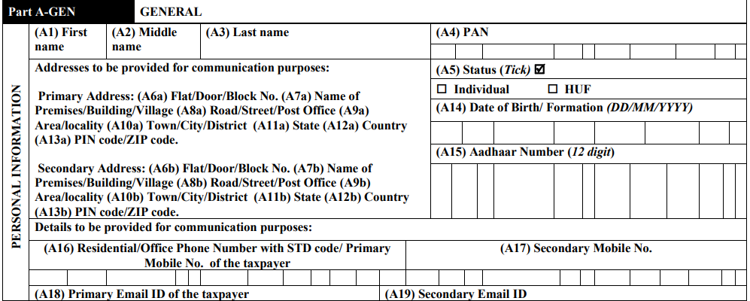
‘Primary Address’ and ‘Secondary Address’

Slide 21
Presumptive Taxation [Section 44AD]:
Eligible Assessee | Individual / HUF / Partnership Firm (not being LLP), who is a Resident.
Applicability | Any business, except plying / hiring / leasing covered in 44AE Person carrying on profession specified u/s. 44AA (Doctor , CA, etc.) Commission / brokerage income excluded from 44AD
Turnover Limit / Threshold | Turnover should not exceed Rs. 2 Crores. However, if 95% receipts are from banking channel (i.e. not in cash), then assessee having Turnover upto Rs. 3 Crores can opt for Section 44AD.
Presumptive Income | 8% of Turnover / Gross Receipts in Cash 6% of Turnover / Gross Receipts through Banking channel

Slide 22
Presumptive Taxation [Section 44AD]:
Basis | Rate of Presumptive Income | Condition
Cash (non-digital receipts) | 8% | Amount received in cash, or outstanding debtors still unrealized as on the Section 139(1) due date
Banking (Digital receipts) | 6% | A/c payee Cheque, A/c payee DD, ECS, or electronic mode under Rule 6ABBA (credit/debit card, IMPS, net banking, UPI, BHIM, NEFT, RTGS) received during the year or up to the Section 139(1) due date
Higher Claim of Profit | Actual % | Assessee may voluntarily declare income higher than 8%/6% - always permissible

Slide 23
Presumptive Income u/s. 44AD - 6% or 8%:
6% applies only if the amount is actually received through a prescribed digital mode during the financial year, or upto the due date of filing the return under Section 139(1).
If the amount remains unrealized as on 139(1) due date, it must be offered at 8%, even if it is collected digitally at a later date.
  Example: Rs. 60 lakh received digitally before the ITR due date → taxed at 6%.
  Example: Rs. 15 lakh still outstanding on the ITR due date → must be taxed at 8%.

Slide 24
When Section 44AD does NOT Apply:
A person carrying on a specified profession referred to in Section 44AA(1) - such persons are governed by Section 44ADA.
A person earning income in the nature of commission or brokerage.
A person carrying on any agency business.
A business already covered under Section 44AE (goods carriage) - though a taxpayer may claim 44AD for other, non-transport business simultaneously.

Slide 25
A person is both a commission agent (or a specified professional) and separately runs an eligible business - can 44AD be opted only for the eligible business portion?
Strictly, a person who derives income from a specified profession or who is a commission agent is not ‘eligible’ for 44AD, and in theory cannot use 44AD even for the otherwise-eligible business income.
In practice, the income-tax e-filing portal permits this bifurcation - turnover from the eligible business may be offered under 44AD, while the commission income is reported on a books/no-accounts basis.
Similarly, a professional may opt for 44ADA for the specified professional income and simultaneously 44AD for business income earned, as per e-filing portal / utility.

Slide 26
5 Years Lock-in if opting out of 44AD:
Liable for Tax Audit : If the provisions of Section 44AD(4) are applicable to the assessee
i.e. where the assessee has claimed benefit of presumptive taxation u/s. 44AD in any previous year. Then if the assessee wants to offer profit lower than 8% or 6%, then the assessee will have to get books of accounts audited u/s. 44AB(e) for current AY and next 5 AY’s as well.
Audit not required if income is less than basic exemption limit.
The lock-in is triggered only by a voluntary decision to declare lower profit - not by disqualification on account of exceeding the turnover threshold.
No such lock-in in Section 44ADA and Section 44AE - a taxpayer may opt in or opt out of these schemes freely, year on year.

Slide 27
TAX AUDIT - Applicability for business where assessee has not opted for Presumptive taxation in earlier years:
If turnover of BUSINESS is upto Rs. 1 Crore - the assessee has started new business (i.e. the for the first time assessee is having Business Income), then the assessee can fill up Balance Sheet and Profit and Loss Account and can file ITR-3 without having to get books of accounts audited. i.e. in such case, the provisions of Section 44AD(4) will not be applicable.

Slide 28
TAX AUDIT - Applicability for business:
General rule: Tax audit is required if total sales, turnover or gross receipts exceed Rs. 1 Crore (subject to Section 44AD)
No audit required (enhanced digital limit) where total turnover/gross receipts does not exceed Rs. 10 Crore, provided aggregate cash receipts and aggregate cash payments each do not exceed 5% of the respective totals - cheques / drafts that are not account-payee are treated as cash.
If 95% or more payments and receipts both, are undertaken through banking channel, then turnover limit is Rs. 10 Crores.

Slide 29
Presumptive Taxation [Section 44ADA]:
Eligible Assessee | Individual or Partnership Firm (not being LLP), who is a Resident
Applicability | Specified Profession [S. 44AA(1)]: Legal profession (i.e. Lawyer), Medical profession (i.e. Doctor), Engineering, or architectural profession (i.e. Architect) or the profession of accountancy (i.e. CA), or technical consultancy or interior decoration or company secretary (i.e. CS) or film artist / actor or IT professional
Gross Receipts Limit / Threshold | Gross receipts should not exceed Rs. 50 Lakhs. However, if 95% receipts are from banking channel (i.e. not in cash), then assessee having Gross receipts upto Rs. 75 Lakhs can opt for Section 44ADA.
Presumptive Income | 50% of Gross Receipts (For Cash and Bank both)

Slide 30
Tax Audit - where assessee wants to declare Profit less than 50%:
Gross Receipts from PROFESSION: Not more than Rs. 50 Lakhs of an assessee who is eligible to opt u/s. 44ADA of the Act.
The assessee wants to declare profit less than 50% of gross receipts.
In such cases, audit of books of accounts is compulsory u/s. 44AB(d) if income exceeds basic exemption limit.
No next 5 Years Lock-in, can be decided each year.

Slide 31
‘Business’ includes ‘Profession’:
Gera Development P. Ltd. v. DDIT (Intl. Taxation), ITA No. 62/Pun/2015, (Order dated 29-07-2016)
Section 2(13): “Business” includes any trade, commerce or manufacture, or any adventure or concern in the nature of trade, commerce or manufacture — a term of wide import.
Section 2(36): “Profession” includes “vocation”
Supreme Court in Barendra Prasad Ray v. ITO [1981] 129 ITR 295 (SC): the word ‘business’ does not necessarily mean trade or manufacture only; it includes within its scope professions, vocations and callings.
Additional CIT v. Ram Kripal Tripathi [1980] 125 ITR 408 (All): Profession is a word of wide import and includes vocation, which is only a way of living.
Practical impact: Income from a non-specified profession [i.e., a profession not listed under Section 44AA(1)] can still be treated as business income and is eligible for Section 44AD.

Slide 32
Can AO make addition u/s. 69C if income offered u/s. 44AD?
Chandigarh ITAT : Nand Lal Popli vs. DCIT
ITA Nos. 1161 & 1162/Chd/2013, order dated 14-06-2016
Issue: Can the Assessing Officer make an addition under Section 69C by using the assessee's own cash-flow statement, after accepting income under Section 44AD?
Held: 'Deemed' means presuming the existence of something which actually is not — the 8% (or higher) is not the assessee's real income, only the taxable figure.
If 8% of gross receipts is deemed income, the remaining 92% is equally deemed expenditure - actual expenditure may be more or less, but for tax purposes it is presumed at 92%.
The obligation to maintain books and get them audited arises only where the assessee claims income lower than the prescribed percentage [Section 44AD(5)].

Slide 33
Cash deposits and 44AD Turnover
Punjab and Haryana HC: CIT vs. Surinder Pal Anand [2010] 192 Taxman 264
Issue: Once presumptive tax under Section 44AD is offered, can each cash deposit entry in the bank passbook still be separately questioned?
Held: Once the exemption from maintaining books of account is available and presumptive tax at 8% of gross receipts is itself the basis for the taxable income, the assessee is not obliged to explain every individual cash-deposit entry in the bank, unless the entry has no nexus with the declared gross receipts.
Revenue could not show that the disputed cash deposits were unexplained or undisclosed - appeal of the Revenue dismissed.

Slide 34
Section 44AD - 8% or 6% Profit or Higher Amt?
Cochin ITAT: Thomas Eapen vs. ITO (2020) 113 taxmann.com 268 (Coch) ITA No. 451/Coch/2019 (Order dated 19.11.2019)
Issue: Where income is offered under Section 44AD, can the AO make an addition under Section 69A/69C for the 92% ‘unexplained’ portion of gross receipts, treated as expenditure?
Held: If the income component (8%) is estimated, the expenditure component (92%) cannot simultaneously be treated as 'actually incurred' and separately taxed — it is only a statutory presumption.
Making the assessee prove the expenditure to the extent of 92% of gross receipts would defeat the very purpose of the presumptive scheme.
Once the AO accepts the applicability of Section 44AD, no separate addition under Section 69A/69C is permissible on the same receipts without a specific finding carving the case out of Section 44AD.

Slide 35
Income from partnership firm – Remuneration Interest, etc.
Bombay High Court : Perizad Zorabian Irani vs. PCIT, Mumbai
[Writ Petition No. 1333/2021 - Order dated 09.03.2022]
Issue: Is a partner's remuneration/interest under Section 28(v) treated as the partner's own business turnover?
Held: Under Section 28(v), interest, salary, bonus, commission or remuneration due to or received by a partner from the firm is chargeable under 'Profits and gains of business or profession' - but this is a deeming fiction for the head of income only.
It cannot be treated as gross receipt/turnover of the partner, because the partner is not carrying on any business or profession independently - it is the firm which carries on the business, in which the assessee is merely a partner.
Directly reinforces the Anandkumar ruling - partner's remuneration/interest is outside the scope of Section 44AD/44ADA for the individual partner.
Refer Para 5.20 of ICAI Guidance Note on Tax Audit (Revised 2026)

Slide 36
The Overriding (Non-Obstante) Nature of the Presumptive Scheme – 44AD(1), 44ADA(1)
“Notwithstanding anything ------------- contained in sections 28 to 43C...”
Each presumptive section opens with this non-obstante clause. the normal computation provisions under sections 28 to 43C stand displaced, to the extent provided by the respective presumptive provision, and the prescribed presumptive income is deemed to be the taxable business/professional income."

Slide 37
Which Provisions Still Apply Despite Opting for the Presumptive Scheme?
The 'notwithstanding' language in Sections 44AD/44ADA/44AE only overrides the computation mechanics of Sections 28 to 43C - it does NOT override procedural or anti-abuse provisions elsewhere in the Act.
Sections 40A(3)/40A(3A) (disallowance for cash payments) — not attracted, because no separate expense is being claimed to disallow in the first place, due to overriding nature of presumptive scheme.
TDS provisions and consequential disallowance under Section 40(a)(i)/40(a)(ia) — the disallowance itself does not apply (no expense being claimed), BUT the obligation to deduct TDS continues; failure still attracts interest under Section 201(1A)/206C(7) and penalty under Section 271C/271CA.
Sections 269SS and 269ST (cash loan/deposit/receipt restrictions) continue to apply in full even where presumptive taxation is opted.
TDS and TCS obligations as a deductor/collector applicable.

Slide 38
Presumptive Taxation [Section 44AE]:
Eligible Assessee | All assessee’s
Applicability | Assessee should not own more than 10 goods carriage and is engaged in the business of plying / hiring / leasing of such goods carraiges.
Presumptive Income | For Heavy Goods Vehicle (i.e. more than 12,000 Kg): Rs. 1,000/- per ton per month of Gross Vehicle Weight (GVW) or unladen weight For Other than Heavy Goods Vehicle: Rs. 750/- per ton per month of Gross Vehicle Weight (GVW) or unladen weight
Example | Truck is having capacity (GVW) of 15,000 Kg (i.e. 15 Ton) and is used for entire FY 2025-26 (12 months). Its presumptive Income u/s. 44AE will be Rs. 1,80,000/-.

Slide 39



Three Pillars of Presumptive Taxation
Section 44AD
Small Business
Section 44ADA
Professionals
Section 44AE
Goods Carriage
Individuals, HUF, Firms (not LLP)
Turnover ≤ Rs. 2 Cr / 3 Cr
8% (cash) / 6% (digital)
5-year lock-in on opting out
Specified professions u/s 44AA(1) excl. LLP
Gross receipts ≤ Rs. 50 L/75 L
50% of gross receipts
No lock-in; yearly opt-in/out
Any assessee, ≤ 10 vehicles
Rs. 1,000/ton (heavy) p.m.
Rs. 7,500 p.m. (other vehicles)
No lock-in; audit if lower profit claimed

Slide 40
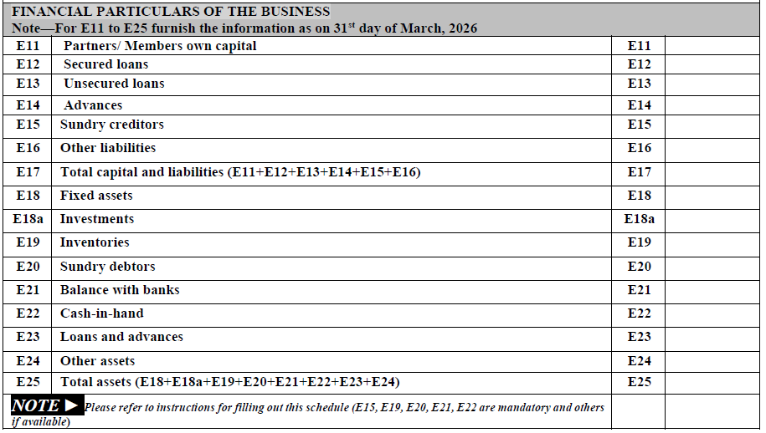
Financial particulars of the Business [ITR-4]:
Compulsory fields: Sundry Creditors, Inventories, Sundry Debtors, Bank Balances, Cash in hand. [Bank Balance now mandatory from AY 2026-27]

Slide 41
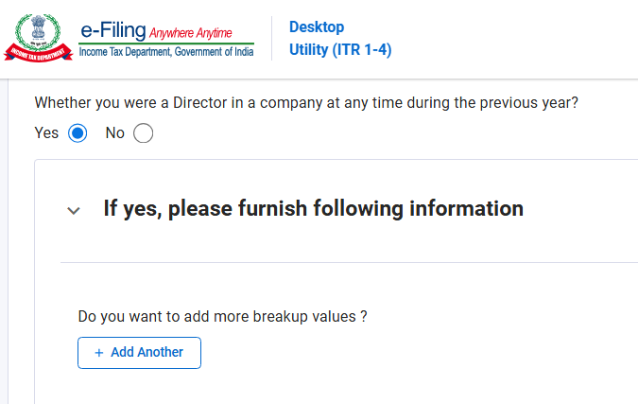
Directorship Details [ITR-3]:

Slide 42
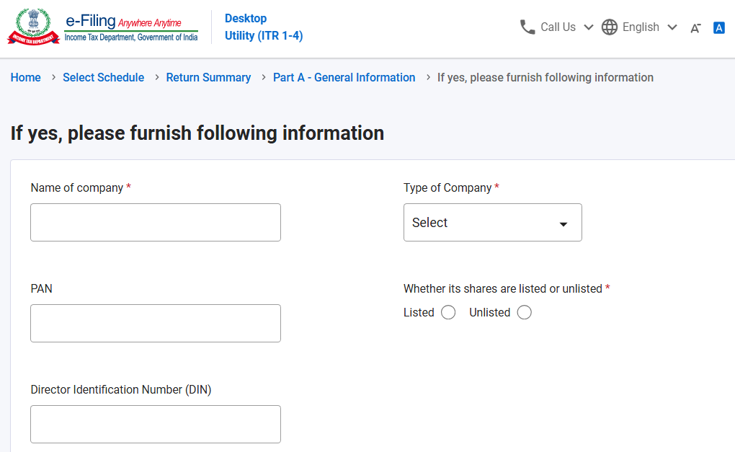
Directorship Details [ITR-3]:

Slide 43
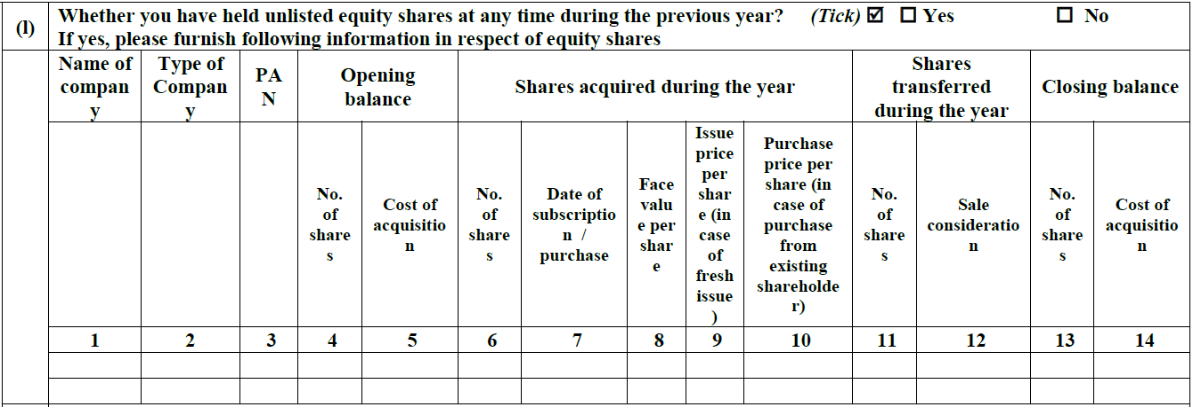
Unlisted Shareholding [ITR-3]:

Slide 44
Opting out from Section 115BAC [10-IEA]:
Assessee having income from business or profession (ITR-3 / ITR-4):
To opt out of the New Tax Regime, such a person will have to file Form 10-IEA on or before the due date of filing return of income u/s. 139(1) of the Act and date of filing Form 10-IEA and its Acknowledgment Number is required to be mentioned in ITR.
NOT having income from business or profession (ITR-1 / ITR-2):
If a person is not having any business income, then such person can Opt out from Section 115BAC by selecting to ‘opt out’ in ITR Form itself and Form 10-IEA is NOT required to be filed.

Slide 45
Section 80C Deductions:
Deduction of upto Rs. 1,50,000/-.
Deduction of LIC, PPF, Sukanya Samriddhi, Senior Citizen Saving Scheme (SCSS), PF, principal repayment of housing loan, ELSS, etc. are covered under section 80C of the Income Tax Act, 1961.
Separate line item has to be used for claiming deduction of each category alongwith Policy number of Document identification number. If a person is claiming say deduction of Rs. 20,000 of LIC premium and Rs. 50,000 being deposited to PPF, then 2 separate entries should be made in the ITR Form alongwith policy number for LIC premium and PPF Account Number for claiming deduction of amount deposited in PPF Account. If deduction is claimed for Sukanya Samriddhi / principal repayment of housing loan, separate entries should be made alongwith document number.

Slide 46
Section 80D - Medical Insurance premium:
Deduction Limit (Maximum: Rs. 75,000):
  Upto Rs. 25,000 for Self, Spouse and Children
  Upto Rs. 50,000 if senior citizen (aged 60 or above)
  Upto Rs. 25,000 for non-senior citizen parents
  Upto Rs. 50,000 for senior citizen parents (incl. medical expenses)
Deduction for Preventive Health Checkup of Rs. 5,000/- (can be in cash also)
No deduction if Medical insurance premium paid in Cash.
Disclosure requirement:
  Name of the Insurer (Insurance Company)
  Policy Number
  Premium Amount

Slide 47
Section 24(b) - Interest on Housing Loan:
Deduction available under the New tax Regime as well in respect of ‘Let out Property’.
Deduction (Self Occupied Property): Maximum Rs. 2 Lakhs
Deduction (Let Out Property): Interest can be claimed as deduction, even if above Rs. 2 Lakhs. However, set-off of House Property Loss of maximum upto Rs. 2 Lakhs shall be allowed and remaining loss can be carried forward upto subsequent 8 Assessment Years.
Additional disclosure requirement:
  Loan taken from: Bank or Other than Bank.
  Name of the bank / institution / person from which the loan is taken
  Loan account Number of the bank / institution
  Total amount of loan
  Principal outstanding as on the last date of the financial year
  Interest on borrowed capital

Slide 48
Deduction u/s. 80E / 80EE / 80EEA / 80EEB:
Additional disclosure requirement for claiming deduction of interest on loan taken for higher education u/s. 80E, interest on housing loan u/s. 80EE and 80EEA, interest for purchase of Electric Vehicle (EV) u/s. 80EEB (available only under the Old Tax Regime):
  Loan taken from: Bank / Institution
  Name of the bank / institution from which the loan is taken
  Loan Account Number
  Date of sanction of Loan
  Total amount of loan
  Loan outstanding as on the last date of the financial year (i.e. as on 31.03.2026)
  Interest amount
  Vehicle Registration Number (for deduction of interest on loan u/s. 80EEB for purchasing E-Vehicle)

Slide 49
Donation deductible u/s. 80G:
Donations u/s. 80G are categorized for 100% deduction or 50% deduction, with or without limit of 10% of adjusted GTI (Old Regime)
Funds such as PM CARES, National Defence Fund, PM Drought Relief Fund, etc. are eligible for 100% deduction whereas ordinary NGO’s registered u/s. 80G are eligible for deduction of 50% of donation amount, subject to maximum 10% of adjusted GTI.
Donation above Rs. 2,000 should be through banking channel and donation upto Rs. 2,000 can be in Cash.
Donor should obtain Form 10BE from the Donee Organization.
Additional Disclosure Requirement:
  PAN and Name of the Donee
  Address
  Donation Reference Number / Receipt Number / 10BE ARN
  Transaction Reference Number
  IFSC Code

Slide 50
Schedule FA (Foreign Assets):
Schedule FA requires reporting of Foreign Assets and Foreign Source Income.
Applicability: Only to residents and ordinarily resident (ROR) and not applicable to residents but not ordinarily residents (RNOR) or to non-residents (NR).
Details required to be reported in Schedule FA:
  A1: Foreign Depository Accounts
  A2: Foreign Custodial Accounts
  A3: Foreign Equity and Debt Interest
  B: Financial Interest in any Entity
  C: Immovable Property
  D: Any other Capital Asset
  E: Account(s) in which assessee is having signing authority
  F: Trusts, created under the laws of a country outside India (Trustee)
  G: Any other income derived from any source outside India

Slide 51
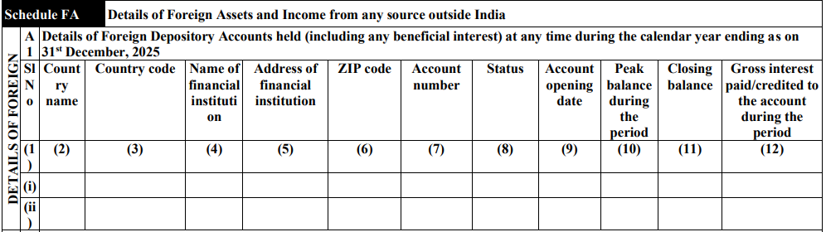
Schedule FA (Foreign Assets):
A1: Foreign Depository Accounts (i.e. Bank Accounts)
Accounts held in foreign depositories, including peak balance, closing balance, and gross interest paid or credited during the calendar year.
Example: Saving Bank Account in Bank of America, Wells Fargo, HSBC, etc. outside India.

Slide 52
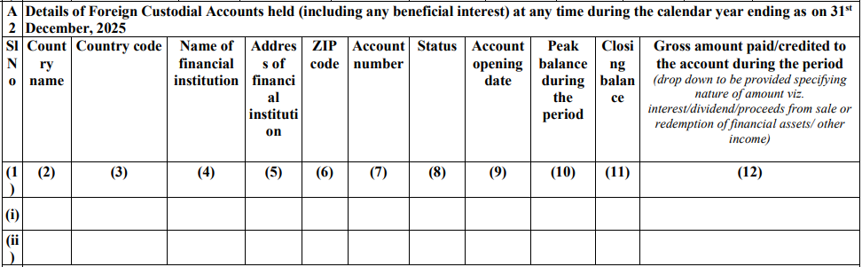
Schedule FA (Foreign Assets):
A2: Foreign Custodial Accounts
Accounts maintained with foreign custodians, including peak balance, closing balance, and gross amounts paid or credited (specified by type: interest, dividend, proceeds from sale, or other income).
Example: Foreign Broker Account holding Shares / Mutual Funds / RSU’s, etc. such as Fidelity, E-Trade Account of Morgan Stanley

Slide 53
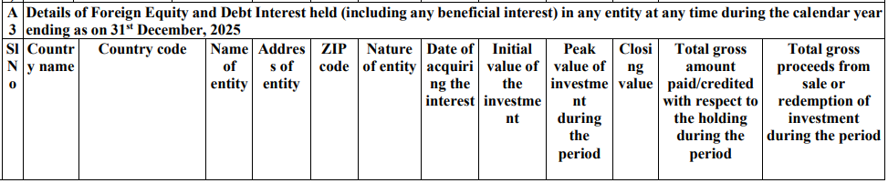
Schedule FA (Foreign Assets):
A3: Foreign Equity and Debt Interest
Investments in foreign equities and debt instruments, including initial value, peak value, closing value, gross interest paid, total gross amounts paid or credited, and proceeds from sale or redemption.
Example: Foreign Shares and Securities, ETF’s, Debentures, etc.

Slide 54
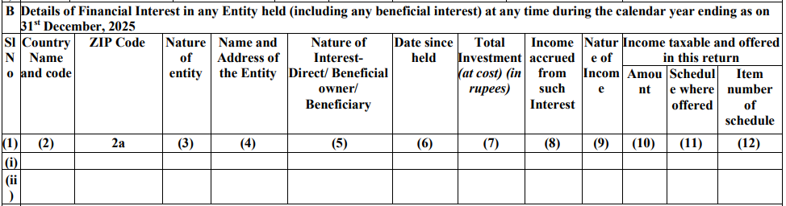
Schedule FA (Foreign Assets):
B: Financial Interest in any Entity
Example: Interest in US LLC, Shares of foreign subsidiary

Slide 55
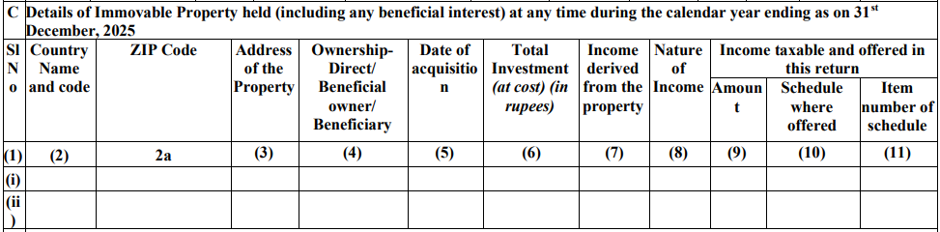
Schedule FA (Foreign Assets):
C: Immovable Property
Details of foreign immovable property holdings, including investment value at cost, nature and amount of income derived, and the amount chargeable to tax in India, with reference to the relevant ITR schedule.
Example: Apartment, Land in any foreign country.

Slide 56
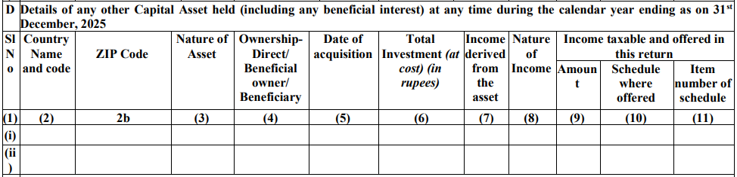
Schedule FA (Foreign Assets):
D: Any other Capital Asset
Examples: Overseas Crypto-currency, Digital currency, NFT, Gold, Silver or other valuable metals held outside India, Valuable paintings, sculptures, etc. (excluding any Stock in trade or business asset)

Slide 57
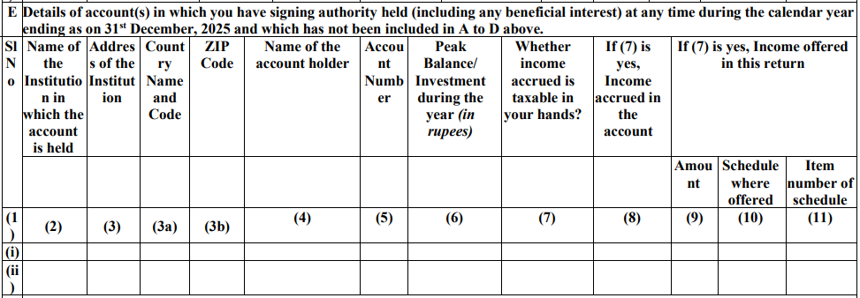
Schedule FA (Foreign Assets):
E: Foreign Accounts with Signing Authority
Examples: Bank accounts of Companies in which assessee is a director having signing authority

Slide 58
Schedule FA (Foreign Assets):
Enhancing Tax Transparency on Foreign Assets & Income
CRS - Common Reporting Standard (OECD):
CRS, is an initiative of the OECD, requiring financial institutions to report information about financial accounts held by foreign residents to their respective tax jurisdictions. The G20 and OECD countries working together developed a Common Reporting Standard (CRS) on Automatic Exchange of Information (AEOI). This information is then exchanged with other jurisdictions annually.
FATCA - Foreign Account Tax Compliance Act (FATCA):
FATCA, enacted by the United States, mandates foreign financial institutions to report accounts held by U.S. taxpayers to the IRS.

Slide 59
Penalty for Non-Compliance [Schedule FA ]:
Penalty under the Black Money (Undisclosed Foreign Income and Assets) and Imposition of Tax Act, 2015. (‘BMA’) [Section 43 of BMA]
“43. If any person, being a resident other than not ordinarily resident in India within the meaning of clause (6) of section 6 of the Income-tax Act, who has furnished the return of income for any previous year under sub-section (1) or sub-section (4) or sub-section (5) of section 139 of the said Act, fails to furnish any information or furnishes inaccurate particulars in such return relating to any asset (including financial interest in any entity) located outside India, held by him as a beneficial owner or otherwise, or in respect of which he was a beneficiary, or relating to any income from a source located outside India, at any time during such previous year, the Assessing Officer may direct that such person shall pay, by way of penalty, a sum of ten lakh rupees:
Provided that this section shall not apply in respect of an asset, being one or more bank accounts having an aggregate balance which does not exceed a value equivalent to five hundred thousand rupees at any time during the previous year”

Slide 60
Residential Status [Section 6]:
RESIDENT AND ORDINARILY RESIDENT (ROR):
You were in India for 182 days or more during the previous year [section 6(1)(a)]
You were in India for 60 days or more during the previous year, and have been in India for 365 days or more within the 4 preceding years [section (6)(1)(c)] [where Explanation 1 is not applicable]
You are a citizen of India, who left India, for the purpose of employment, as a member of the crew of an Indian ship and were in India for 182 days or more during the previous year and 365 days or more within the preceding 4 years [Explanation 1(a) of section (6)(1)(c)]
You are a citizen of India or a person of Indian origin and have come on a visit to India during the previous year and were in India for:
  182 days or more during the previous year and 365 days or more within the preceding 4 years; or
  120 days or more during the previous year and 365 days or more within the preceding 4 years if the total income, other than income from foreign sources, exceeds Rs. 15 lakh. [Explanation 1(b) of section (6)(1)(c)]

Slide 61
Residential Status [Section 6]:
RESIDENT BUT NOT ORDINARILY RESIDENT (RNOR):
You have been a non-resident in India in 9 out of 10 preceding years [section 6(6)(a)]
You have been in India for 729 days or less during the 7 preceding years [section 6(6)(a)]
You are a citizen of India or person of Indian origin, who comes on a visit to India, having total income, other than the income from foreign sources, exceeding Rs. 15 lakh and have been in India for 120 days or more but less than 182 days during the previous year [section 6(6)(c)]
You are a citizen of India having total income, other than the income from foreign sources, exceeding Rs. 15 lakh during the previous year and not liable to tax in any other country or territory by reason of your domicile or residence or any other criteria of similar nature [section 6(6)(d) rws 6(1A)]

Slide 62
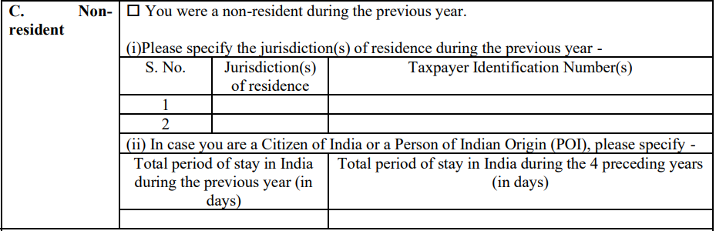
Residential Status [Section 6]:
NON-RESIDENT (NR):

Slide 63
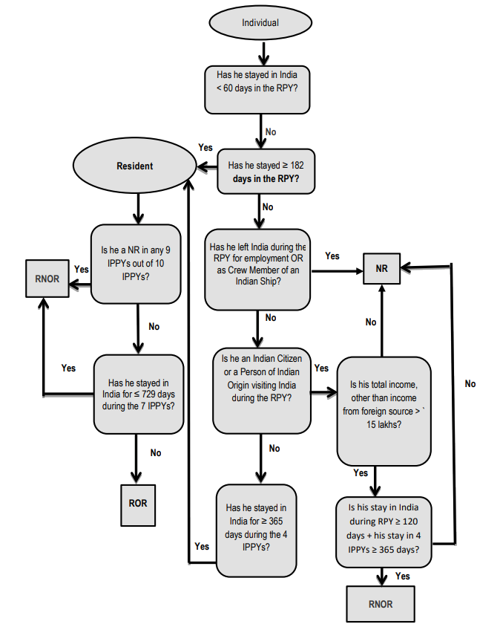
Residential Status [Section 6]:

Slide 64
Schedule AL (Assets and Liabilities):
Under Schedule AL, following details are required to be reported:
Immovable Assets (Land, Building, etc.) incl. Address, PIN Code (at cost)
Movable Assets (at cost)
  Jewellery
  Archaeological collections, drawings, painting, sculpture or any work of art
Vehicles, yachts, boats and aircrafts (at cost)
Bank (including all deposits), Shares and securities, Insurance policies, Loans and advances given, Cash in hand
Liabilities in relation to such assets.
Upto AY 2024-25, assessee’s were required to furnish the details under Schedule AL if their total income was more than Rs. 50 Lakhs. However, from AY 2025-26 onwards, threshold limit has been increased and details in Schedule AL are required to be submitted only if the total income exceeds Rs. 1 Crores.

Slide 65
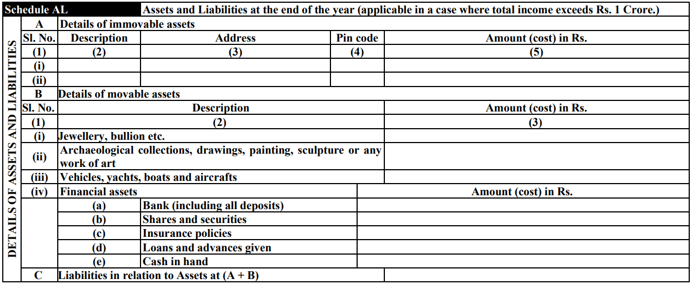
Schedule AL (Assets and Liabilities):

Slide 66
The Char Dham of Income Tax Portal:
Outstanding Demand:
  Check for any outstanding tax demand.
  Verify whether the demand is correct or incorrect.
  Submit response before filing, wherever required.
Profile Verification:
  Verify whether Primary Email ID and Primary Mobile Number and Secondary Email ID and Secondary Mobile Number are correctly updated.
  Verify whether correct Address is mentioned with PIN Code.
Bank Account Validation:
  To ensure all active bank accounts are validated and dormant / closed bank accounts are removed
E-Proceedings:
  Check for any pending Notices and verify if any compliance is pending

Slide 67
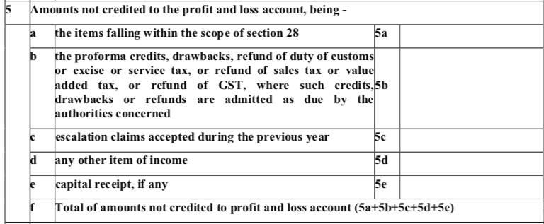
Schedule OI of ITR and Clause 16 of Tax Audit Report - Amounts not credited to the Profit and Loss Account and its disclosure in ITR:

Slide 68
Schedule OI of ITR and Clause 16 of Tax Audit Report - Amounts not credited to the Profit and Loss Account and its disclosure in ITR:
The reporting under Clauses 16(d) and Clause 16(e) are inter-linked with Schedule OI of the Income tax return.
Accordingly, if any amount is mentioned in Clause 16(d) / Clause 16(e), then the same should also be mentioned in Schedule OI of ITR Form and the same is required to be added to the total income of the assessee in the Computation of Income.
Otherwise, the same would result in addition vide Intimation u/s. 143(1) of the Act.

Slide 69
Schedule OI of ITR and Clause 16 of Tax Audit Report - Amounts not credited to the Profit and Loss Account and its disclosure in ITR:
Clause 16(d) – Amounts not credited to the Profit and Loss Account, being “any other item of income”
It is observed that many a times, tax auditors report items such as :
    Interest on Saving Bank Account
    LIC Refund
    Interest on FDR (Personal)
    Agriculture Income
    Minor Income
    Share in Firm / Remuneration / Interest from partnership firm
However, the same are NOT to be reported under this Clause 16(d).

Slide 70
Schedule OI of ITR and Clause 16 of Tax Audit Report - Amounts not credited to the Profit and Loss Account and its disclosure in ITR:
Clause 16(e) – Amounts not credited to the Profit and Loss Account, being “Capital receipt, if any”
It is observed that many a times, tax auditors report items such as :
    Capital gain from sale of property being capital asset or sale of rural agricultural land, which is not a capital asset
    LIC Refund
    Profit on Sale of fixed assets
    Subsidy for depreciable fixed assets
    Gifts (incl. gifts from relatives)
However, the same are NOT to be reported under this Clause 16(e).

Slide 71
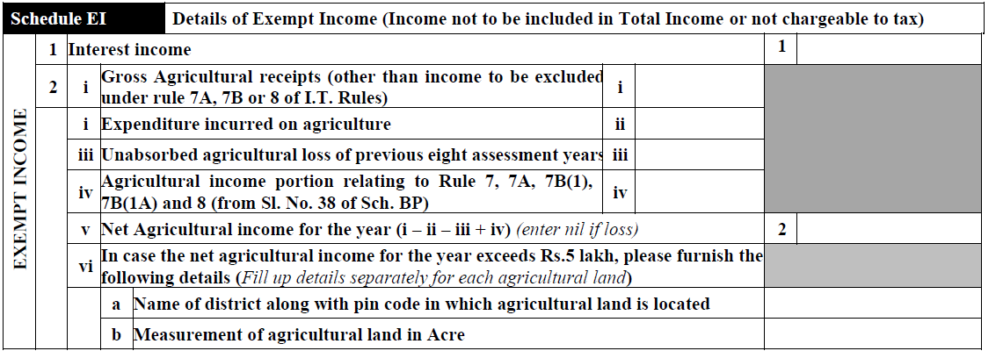
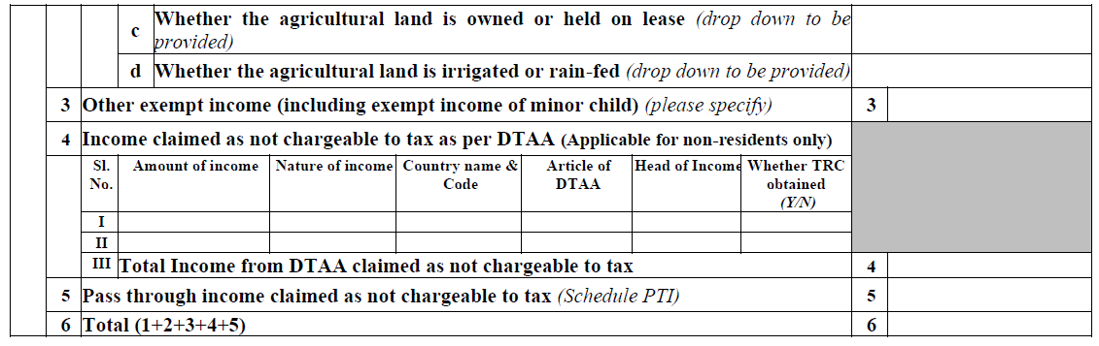
Exempt Income:

Slide 72
Disallowance of delay payment of PF / ESIC under Section 36(1)(va):
The Hon’ble Supreme Court in the case of Checkmate Services Private Limited vs. CIT (Civil Appeal No. 2833/2016) has held that employees contribution paid after due date under respective Act is liable to be disallowed.
Principle of Natural justice ?
Real Income theory ?
Under the Income Tax Act, 2025 – PF / ESIC deposited after due date under respective Act but deposited on or before the due date of filing return of income – then allowable.

Slide 73
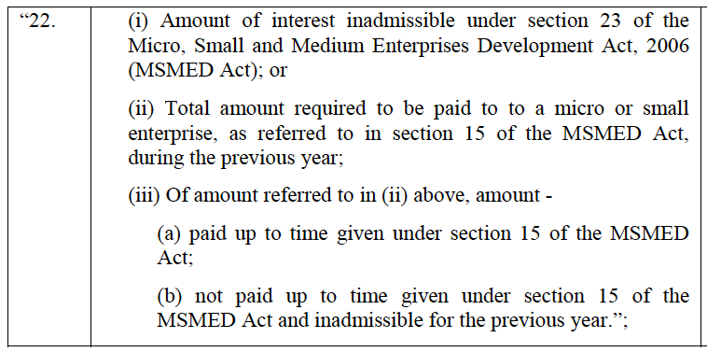
Disallowance of Interest paid to MSME and delay payments to Micro and Small Enterprises under Section 43B(h) :

Slide 74
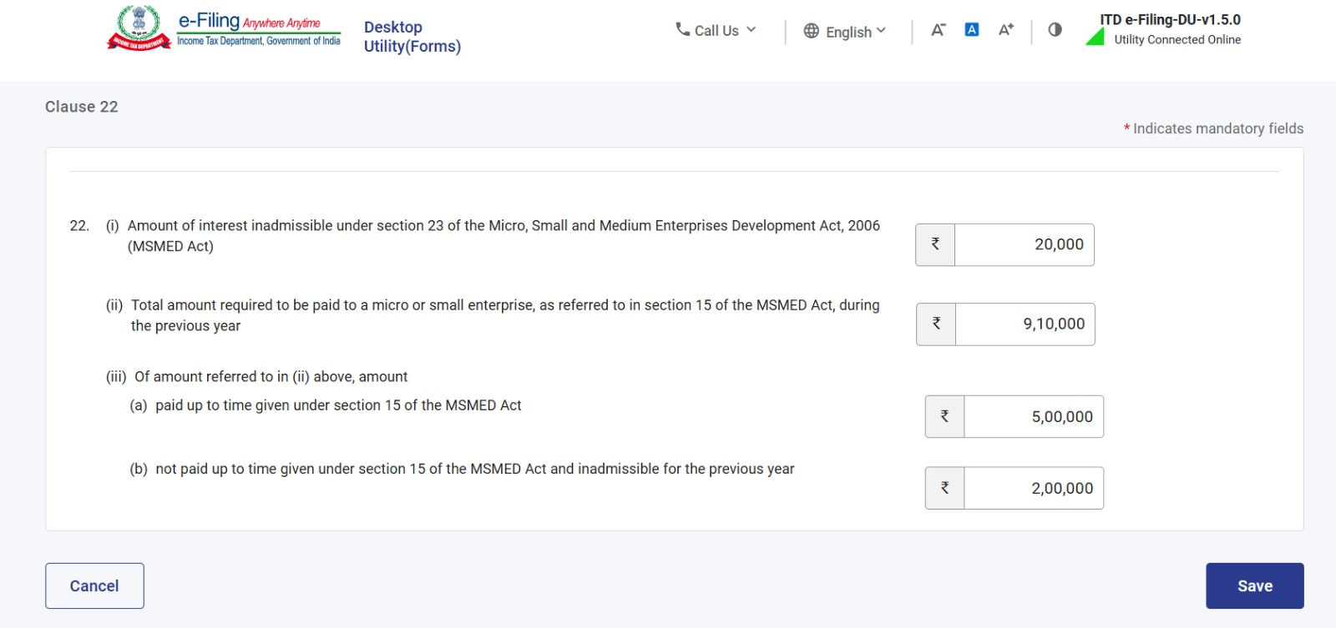
Disallowance of Interest paid to MSME and delay payments to Micro and Small Enterprises under Section 43B(h) :

Slide 75
Disallowance of Interest paid to MSME and delay payments to Micro and Small Enterprises under Section 43B(h) :
Payments to Micro and Small Vendors (not being trading concerns) and Interest payable to MSME
If any amount is debited in the P&L Account on account of Interest paid / payable to Micro, Small and Medium Enterprises (‘MSME’), then as per Section 23 of the MSME Act, 2006, the same is required to be disallowed in the Computation of Income.
Section 23 of MSME Act, 2006 reads as under:
“Notwithstanding anything contained in the Income-tax Act, 1961 as per section 23 of MSMED Act, 2006 interest, as calculated under section 16 shall not be allowed as a deduction for the purposes of the computation of income under the Income-tax Act, 1961.”

Slide 76
Interest on GST / Service tax / GST Late Fee:
Interest on late payment of VAT / GST / Service tax, GST Late fees, etc. are compensatory in nature and not penal in nature and are thus, allowable expenditure.
  Hon’ble Supreme Court - Mahalaxmi Sugar Mills Co. v. CIT (1980) 123 ITR 429.
  Hon’ble Supreme Court - Lachmandas Mathuradas vs CIT [2002] 254 ITR 799.
  Hon’ble Supreme Court – Hyderabad Allwyn Metal Works Ltd. vs. CIT (172 ITR 113).

Slide 77
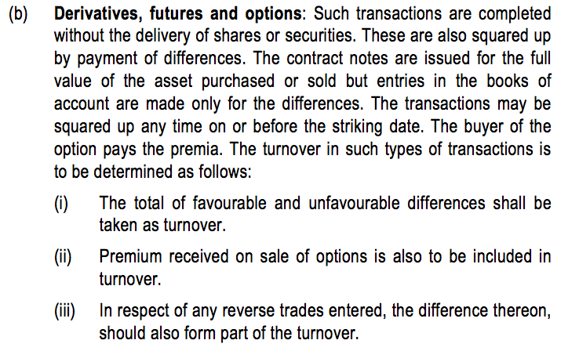
Calculation of Turnover – Derivatives:
ICAI Old Guidance Note on Tax Audit under Section 44AB upto 2022 :

Slide 78
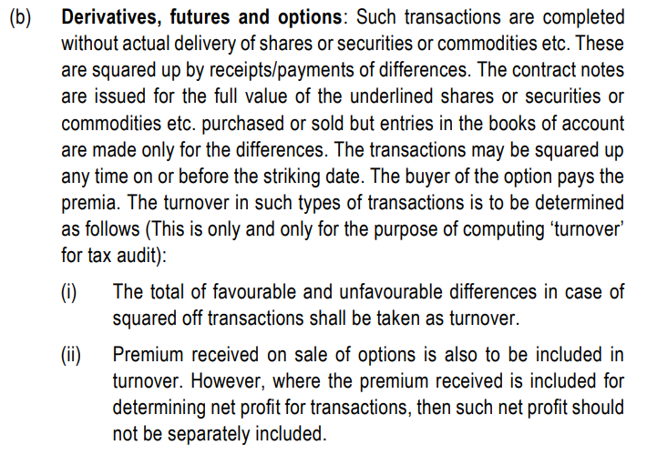
Calculation of Turnover – Derivatives:
ICAI Guidance Note on Tax Audit under Section 44AB (Revised 2026) :

Slide 79
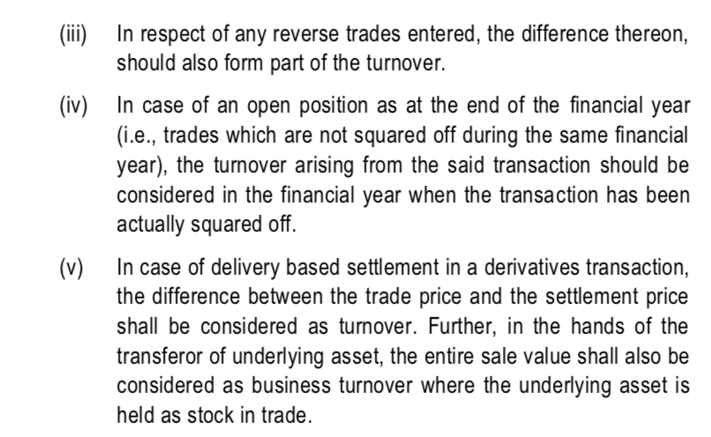
Calculation of Turnover – Derivatives:
ICAI Guidance Note on Tax Audit under Section 44AB (Revised 2026) :

Slide 80
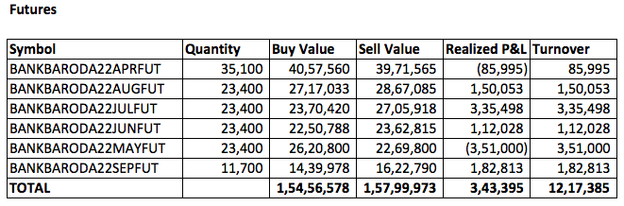
Calculation of Turnover - Futures:
In simple words - Turnover in case of Futures is total of transaction-wise profit or loss on absolute basis. (i.e. ignoring the negative sign)

Slide 81
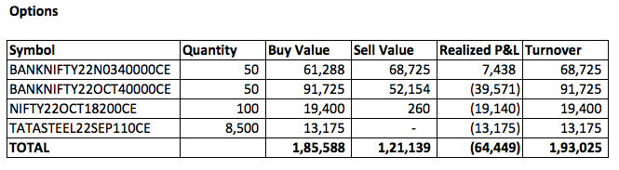
Calculation of Turnover - Options:
In simple words - Turnover in case of Options is Sell side Premium or buy side premium, whichever is higher.

Slide 82
Calculation of Turnover - Options:
Example: Call Option purchased
Premium paid – Rs. 100
Premium received – Rs. 120
What will be the Turnover?
  (a) Rs. 20
  (b) Rs. 100
  (c) Rs. 120
  (d) Rs. 140

Slide 83
Calculation of Turnover - Options:
Example: Call Option purchased
Premium paid – Rs. 100
Premium received – Rs. 120
What will be the Turnover?
  (a) Rs. 20
  (b) Rs. 100
  (c) Rs. 120
  (d) Rs. 140

Slide 84
Calculation of Turnover - Options:
Example: Call Option purchased
Premium paid – Rs. 100
Premium received – Rs. 80
What will be the Turnover?
  (a) Rs. 20
  (b) Rs. 800
  (c) Rs. 100
  (d) Rs. 120

Slide 85
Calculation of Turnover - Options:
Example: Call Option purchased
Premium paid – Rs. 100
Premium received – Rs. 80
What will be the Turnover?
  (a) Rs. 20
  (b) Rs. 80
  (c) Rs. 100
  (d) Rs. 120

Slide 86
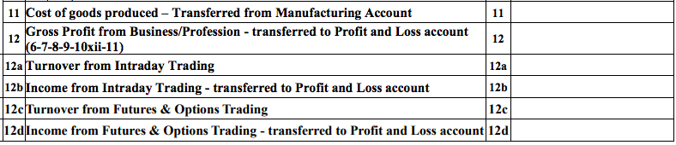
Disclosure of Derivatives Turnover in ITR:

Slide 87
New Business Codes in ITR - also to be reported in Clause 10(a) of the Tax Audit Report:
09029 — Commission Agents (Kachcha Arahtiya): agents working purely under commission, without ownership of the goods traded — relevant to the 'commission agent excluded from 44AD' discussion earlier.
16021 — Social Media Influencers: covers earnings from brand deals, sponsored promotions and similar digital-economy income streams.
21009 — Speculative Trading: Intraday trading or trades settled the same day.
21010 — Futures & Options (F&O) Trading: trading in derivatives on recognised stock exchanges.
21011 — Buying and Selling Shares: delivery-based equity trading.
Selecting the correct business code assists in avoiding automated mismatch flags and helps the Department correctly classify the nature of income for risk-assessment purposes.
Correct business code = better classification and fewer automated mismatches.

Slide 88
Points to keep in mind while filing ITR:
Ensure proper verification of AIS / TIS / 26AS, all SFT details, 26QB
TDS Mapping - reflecting correct head under which income offered
Remember to carry forward TDS if income not of current year
Verify Computation with Tax Audit Report (Part A - OI in ITR)
Reconciling GST Turnover with monthly / quarterly GST Returns (GSTR 3B /GSTR 1 / CMP-08)
Interest on IT Refund to be offered in ITR – Other Sources Income
Verify documents (registry) for Capital Gains from sale of immovable property
Select correct nature of business (21009: for intraday trading, 21010: for F&O trading, 21011: for delivery based trading of shares, 16021 for social media influencers)
Advance tax Liability – if substantial 234B / 234C Interest
Return of loss should be filed within due date.

Slide 89
Thank You !
CA. Apurva Mehta
Date: 1st October, 2026
Online Webinar hosted by DTC, ICAI

